Slide 1
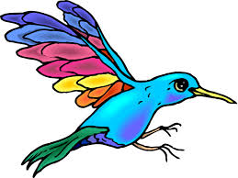
Step 1
Make a character

Slide 2
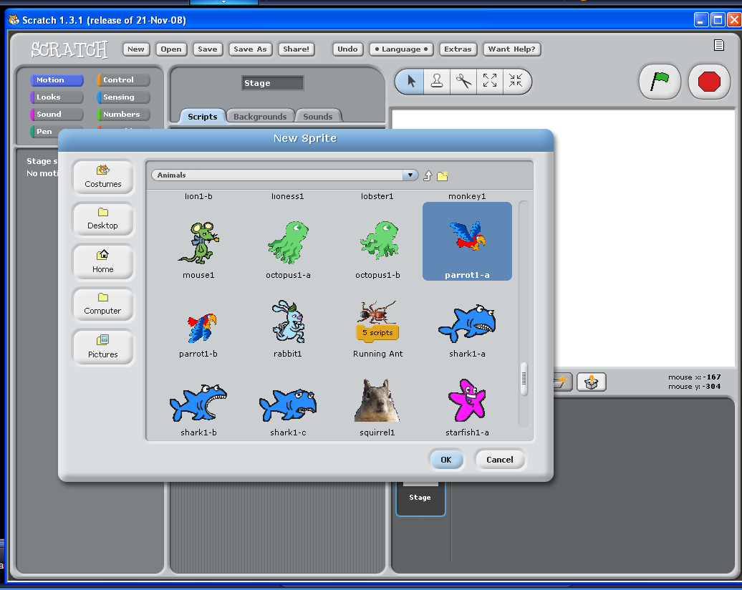

Slide 3
Step 2
Make the character move

Slide 4
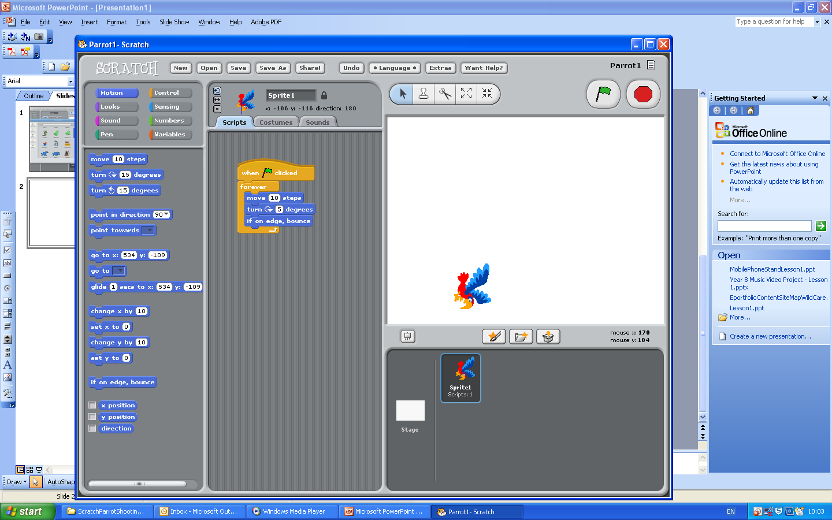

Slide 5
Step 3
Make the character move in lots of ways

Slide 6
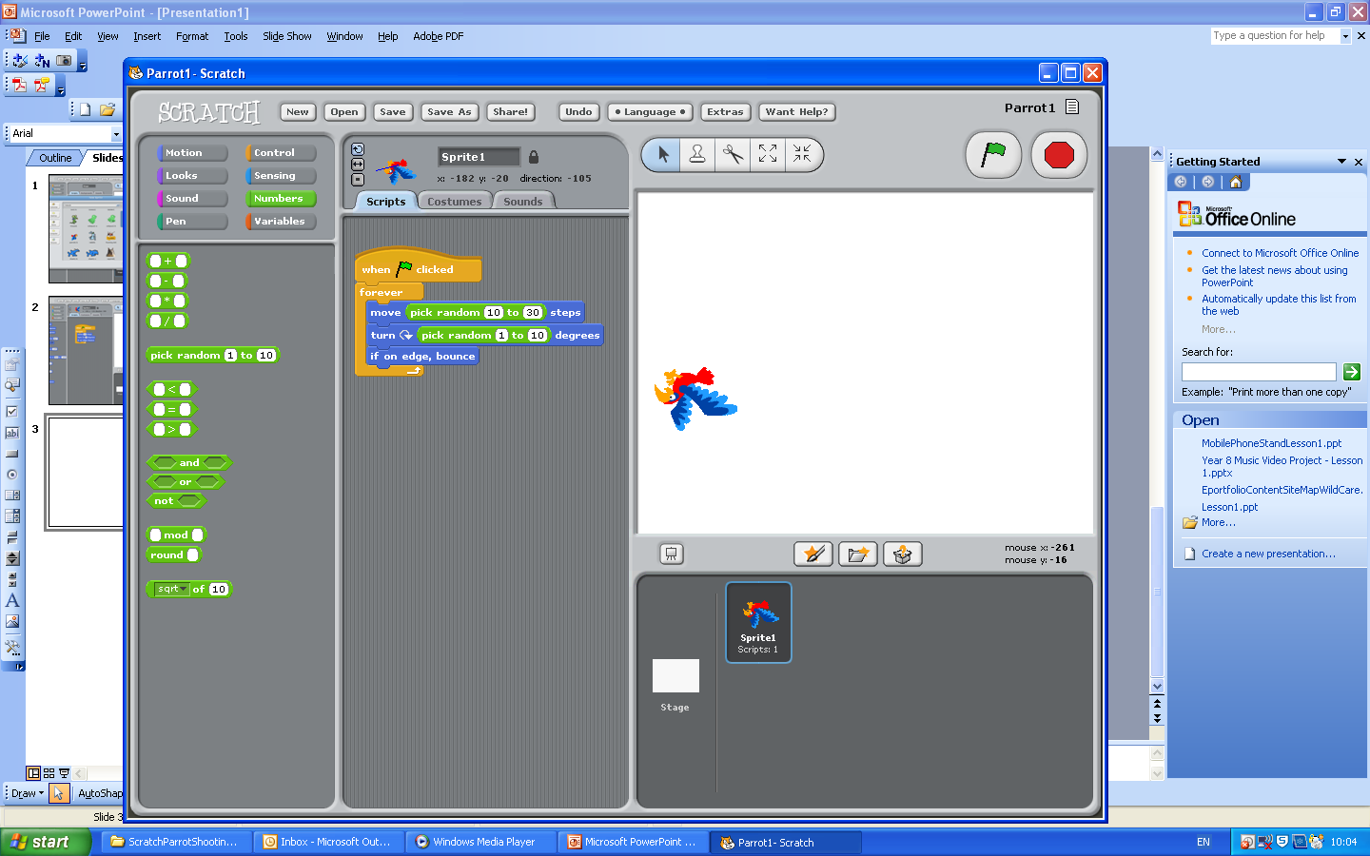

Slide 7
Step 4
Make lots of characters

Slide 9

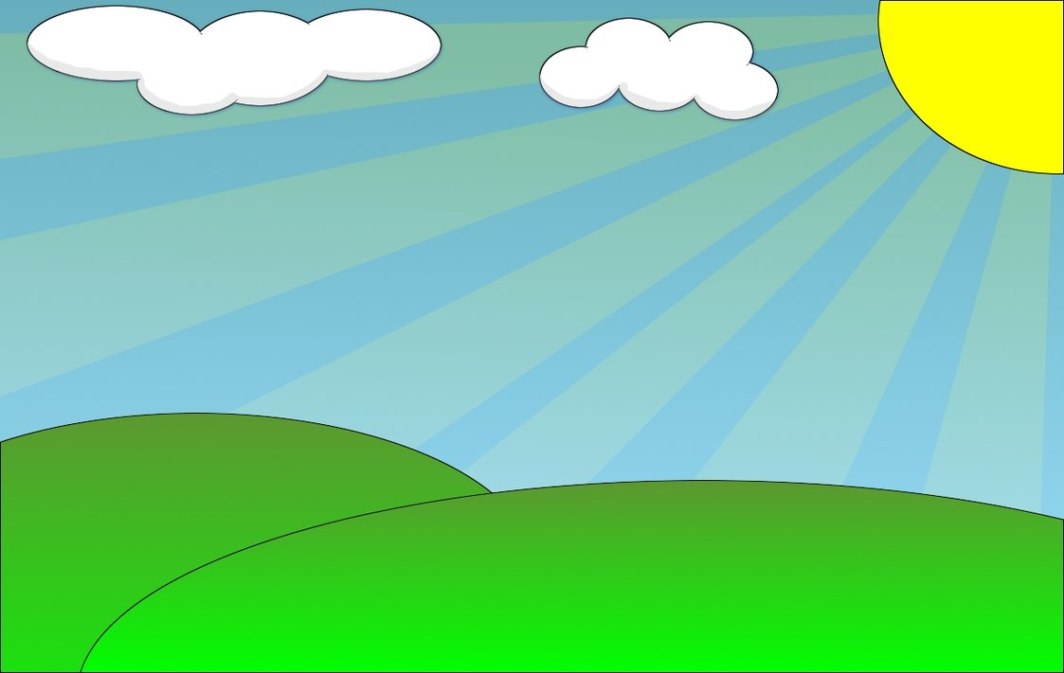
Step 5
Make a background

Slide 10
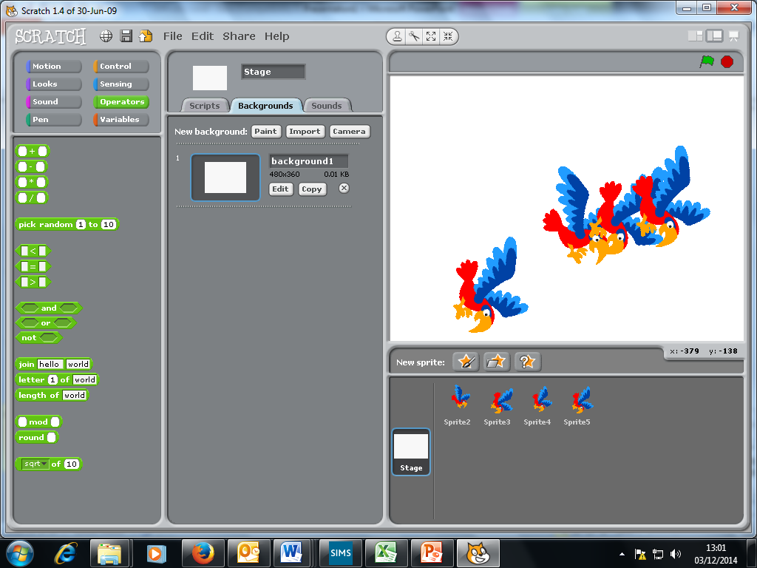
2
1

Slide 11
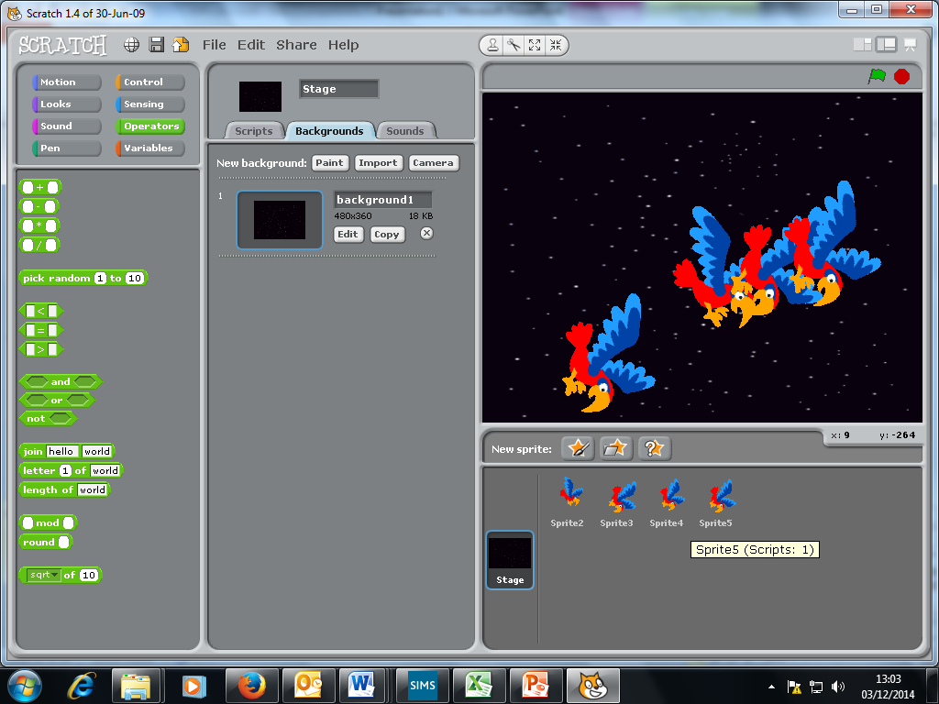

Slide 12

Step 6
Make a new character

Slide 13
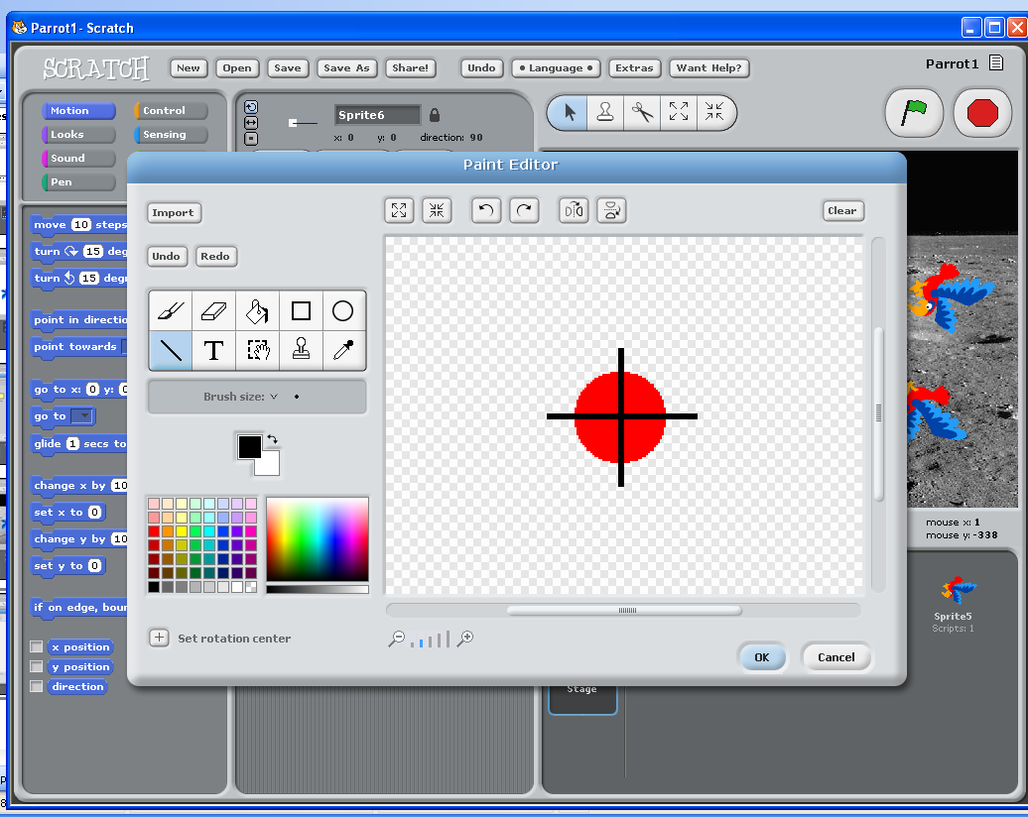

Slide 16
Step 7
Shooting the parrots

Slide 17
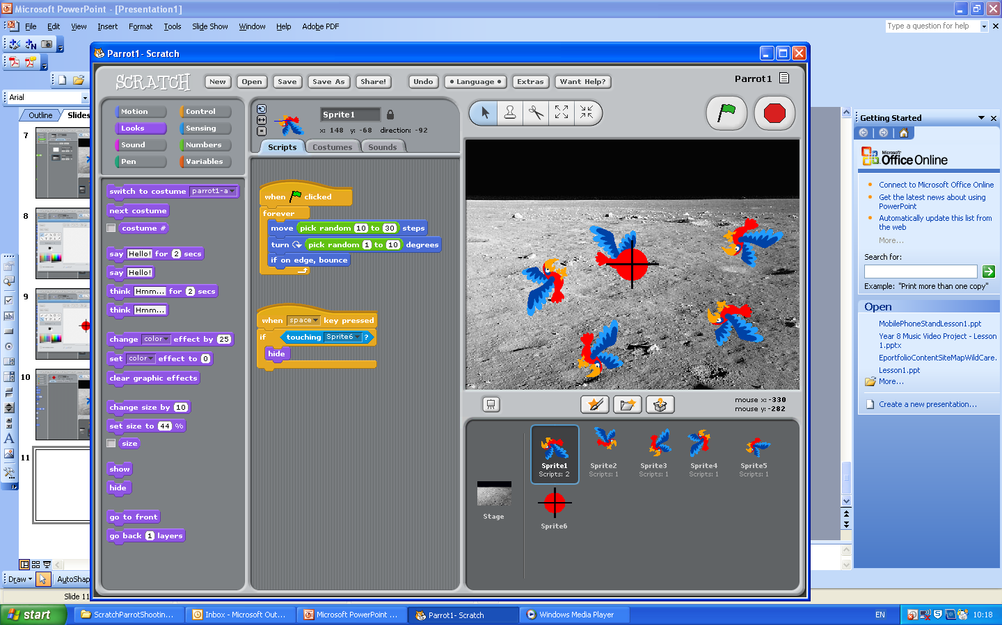

Slide 18
Step 8
Moving the target

Slide 19
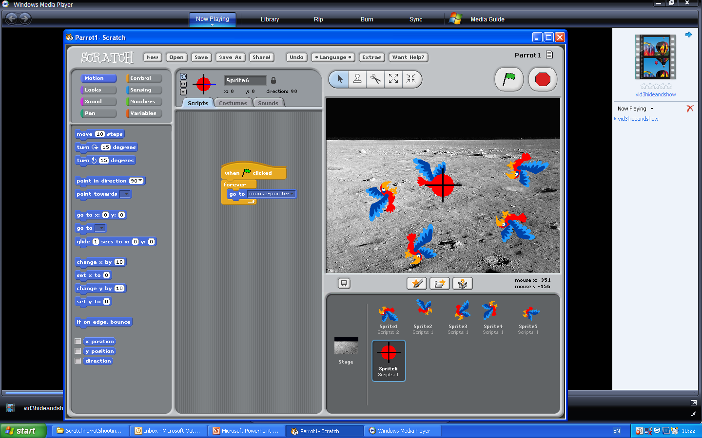

Slide 20
Step 9
Make parrots appear again

Slide 22


Slide 23
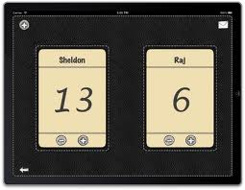
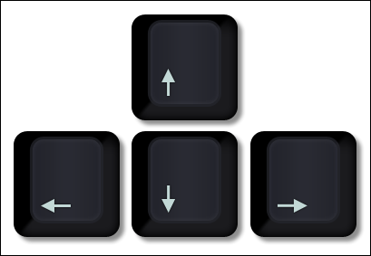
EXTENSION
Add a scoreboard
Make the target move using the keyboard

